Slide 1
Insights Reports of leading fashion brand retailer, Australia
October, 2017

Slide 2

Table Of Contents
Overall - Total Sales and Revenue in the given time period
Attributes - Time of Day, Day of Week, Geography, Payment Type
Top products in terms of sales and revenue
Trends based on different age groups and gender
Impact of temperature on purchase
Basket - Avg. unique quantity, revenue per order
Frequency of single and multiple purchases
Product affinity
segmentation of the brand's audience
This Photo by Unknown Author is licensed under CC BY-SA

Slide 3

Trends of Total sales and revenue by dates
Insights: There is a seasonal trend in the distribution of the revenue throughout the days. In the beginning of every week the sales is increased. Some offers might have been offered by the fashion brand in those days. Strategy: These types of discounts may be offered to the customers in the weekends to maximize the reach.
MiQ Insights | Australian Fashion Brand Retailer | October, 2017

Slide 4
Total sales and revenue by hour
Insights: The distribution of the revenue and sales looks higher in the evening time between 6pm to 7pm. Strategy: Bid may be increased in between this hour to maximize the reach as people become free from work during this time.
MiQ Insights | Australian Fashion Brand Retailer | October, 2017

Slide 5
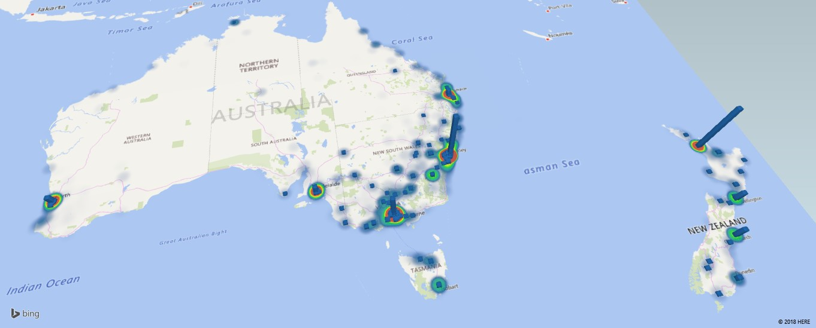
Top cities in respect of revenue and sales
City | Revenue($) | Order%
Sydney | 514972.98 | 3%
Auckland | 329314.86 | 3%
Melbourne | 255013.06 | 2%
Surry Hills | 118045.43 | 1%
Christchurch | 73047.02 | 1%
Wellington | 70484.22 | 1%
North Sydney | 80343.34 | 1%
Sydney and Auckland are the most revenue generating cities
Almost 6% of the total orders are coming from Sydney and Auckland. These areas can be heavily targeted.
MiQ Insights | Australian Fashion Brand Retailer | October, 2017

Slide 6
Overall distribution of sales and revenue by payment types
Almost 48% of total order count is from cc@Braintree which is almost equal to the total order count of paypal@Braintree and pbi@afterpay together.
MiQ Insights | Australian Fashion Brand Retailer | October, 2017

Slide 7
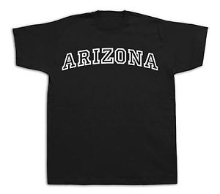
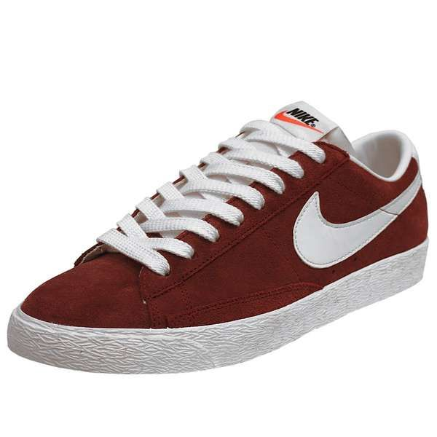
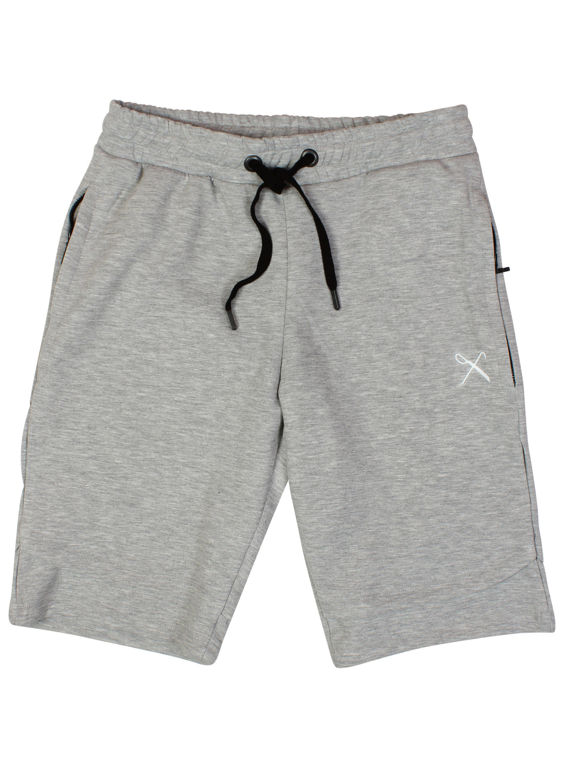
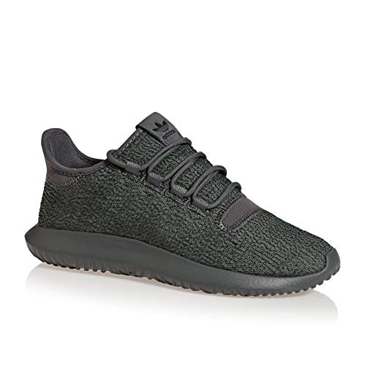
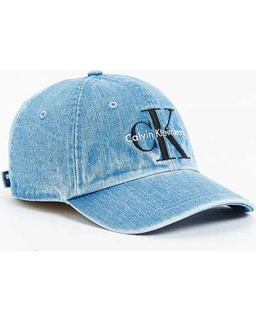
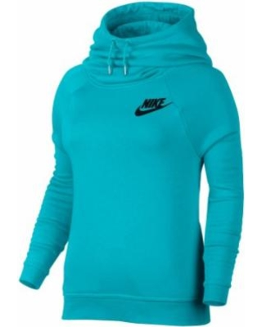
Top Revenue Products
5 in top 6 revenue generating products are also top selling.
1.3 % of revenue consists of these 6 products.
MiQ Insights | Australian Fashion Brand Retailer | October, 2017

Slide 8
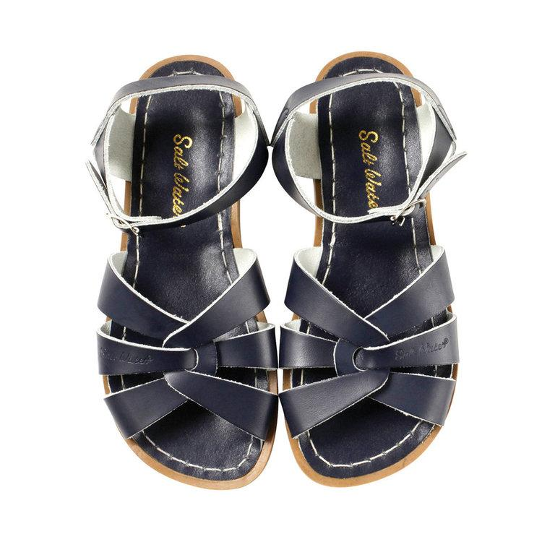
Top Sold Products
$111
$146
$117
$117
$148
Average Order Value
$143
5 in top 6 sold products were also the top revenue generating
MiQ Insights | Australian Fashion Brand Retailer | October, 2017

Slide 9
Trends based on different age groups
Age group of 26 – 35 years are the highest performing age group in terms of buying.
Females belong to this age group can be targeted as 85% of the buyers are female.
MiQ Insights | Australian Fashion Brand Retailer | October, 2017

Slide 10
Effects of temperature on sales
Analysis of 2 top performing city of Australia and New Zealand
Auckland
Sydney
There is a trend of increase in sales when the temperature increases. Some possible reason behind this is- people are at home and shopping online or there is a possibility that some discounts or offers were going on those days. So according to those factors, the campaign can be optimized.
MiQ Insights | Australian Fashion Brand Retailer | October, 2017

Slide 11
Analysis on single and multiple purchasers
Distribution of both the sales count and revenue shows that almost 86% of the buyers are single purchaser.
Average order value for the single and multiple purchasers are almost same which is $131 and $134 respectively.
 | Single Purchaser | Multiple Purchaser
Counts | 85085 | 13745
Purchase Frequency | 1 | 2.33
N.B. Purchase frequency=(Total no of orders/No of unique customers)
Overall average unique quantity | 2
Overall average revenue per order | $134
MiQ Insights | Australian Fashion Brand Retailer | October, 2017

Slide 12
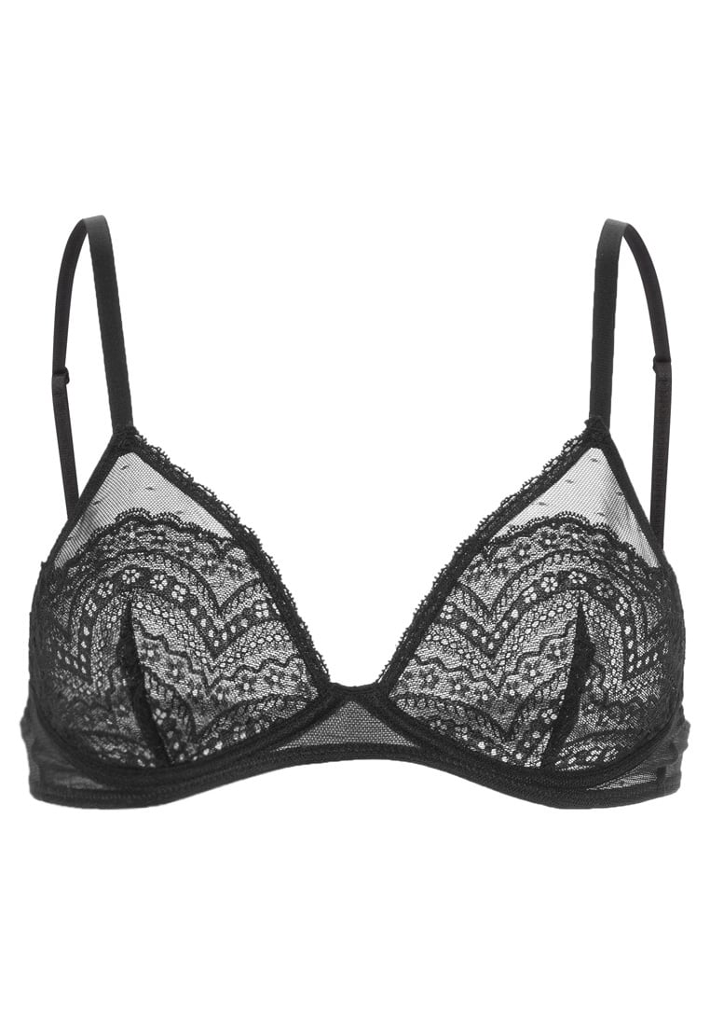
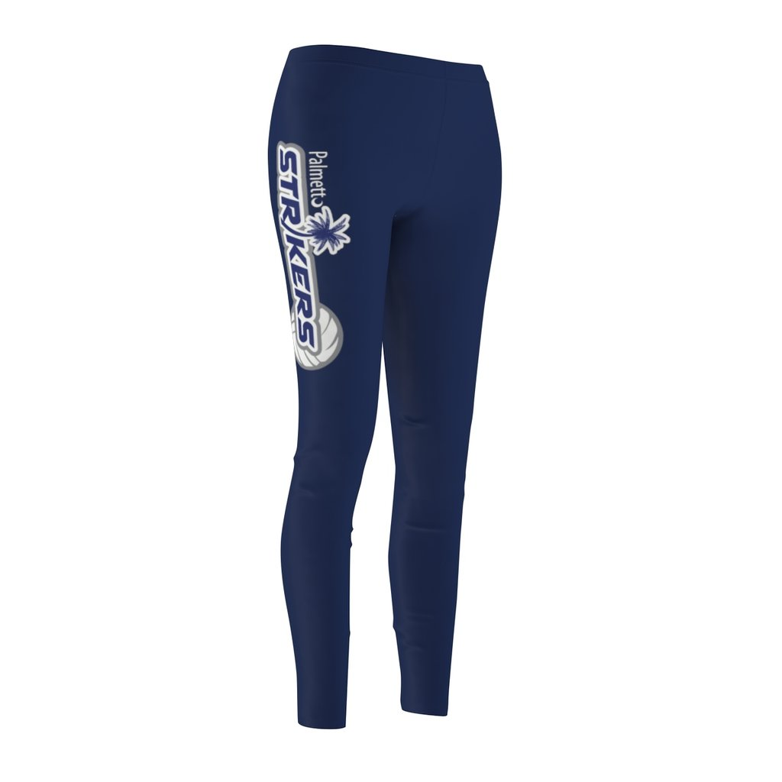
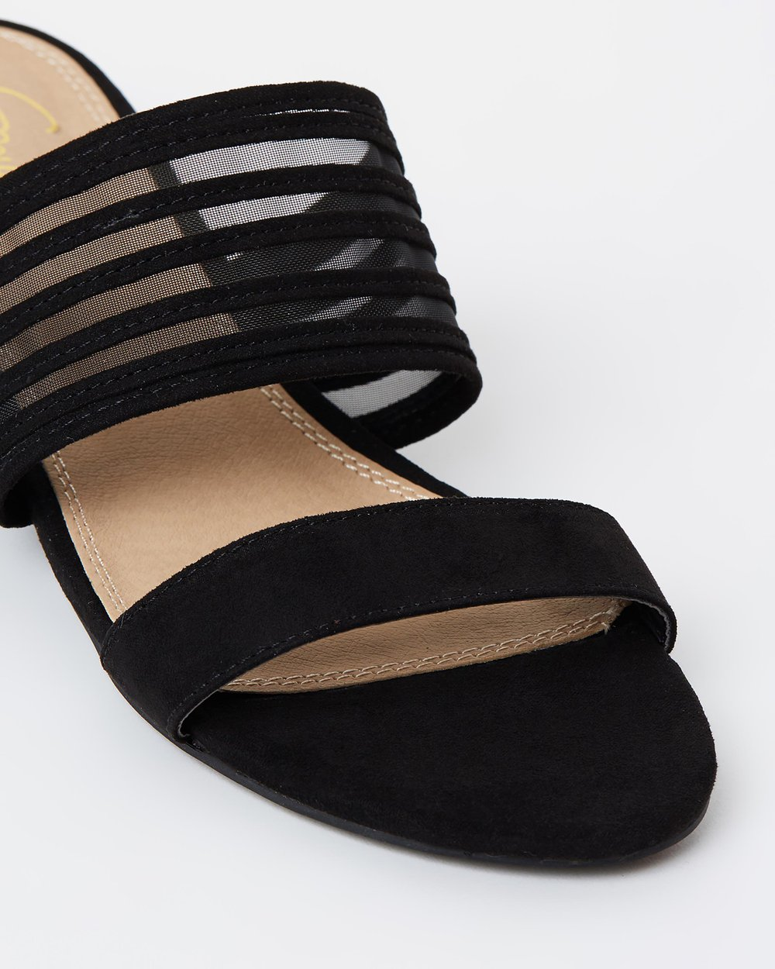
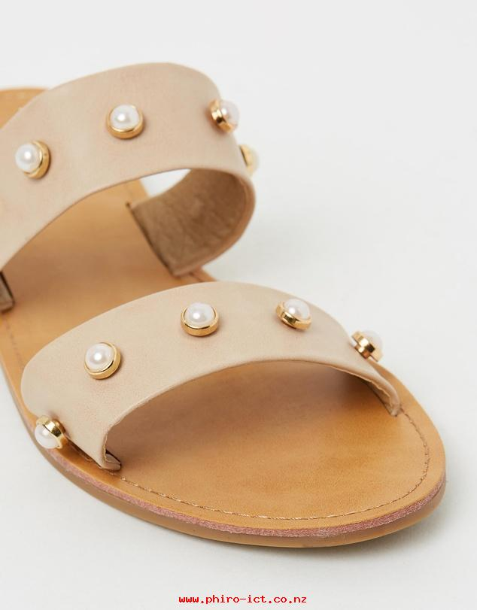
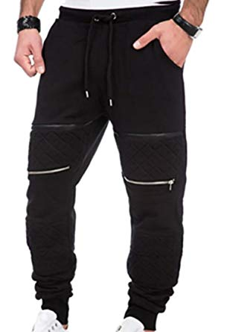
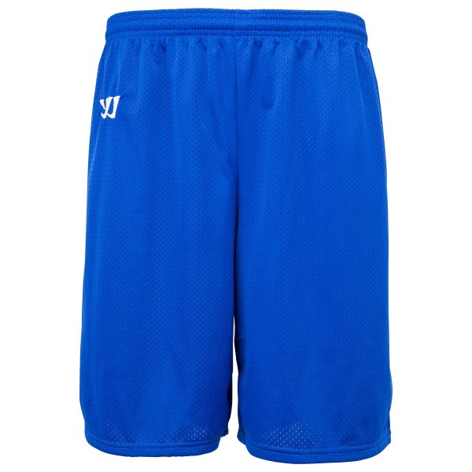
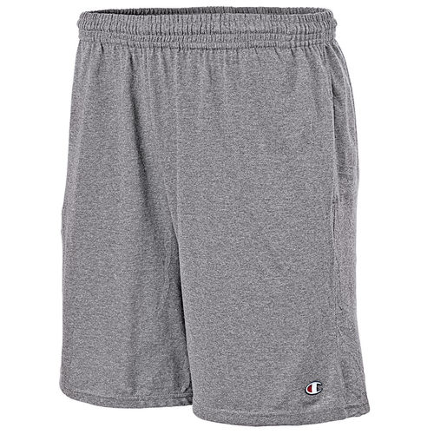
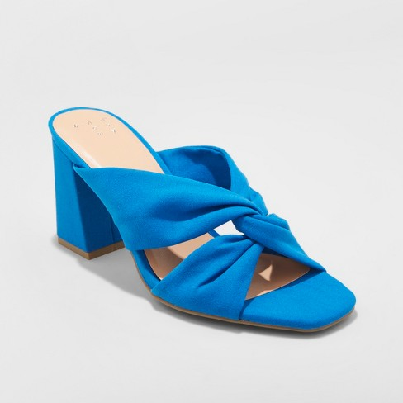
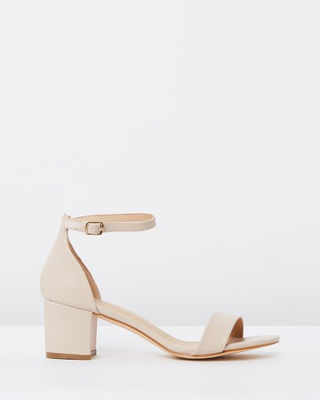
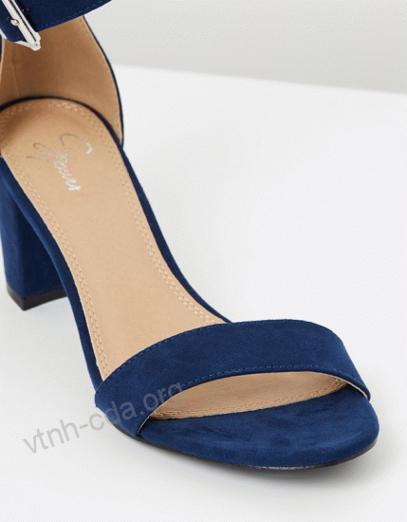
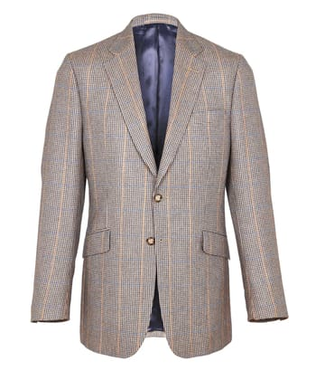
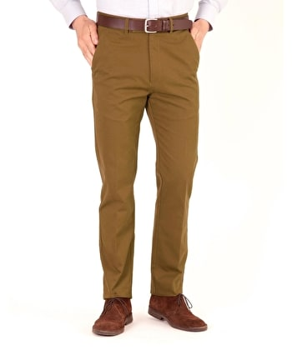
Product Affinities – Weekly Analysis
First Week
Palmetto Bra
Palmetto tights
Iika Slides
Tacita Pearl Stud Slides
Men’s Skinny leg sweatpants
Warrior Shorts
Champion Jersey Shorts
Second Week
Adina Block heels
Lunar Block heels
Amelia Block heels
Third Week
Turner Suit Jacket
Turner Suit Trousers
MiQ Insights | Australian Fashion Brand Retailer | October, 2017

Slide 13
METHODOLOGY
Based on the ‘Revenue’ from the data , total customers have been segmented into 3 segments, viz High, Medium and Low.

Slide 14

User Segmentation
High Value Segment
Total Users : 3104
Order Value Range : $783 - $7010
Average Order Value : $1266
Top Sold Products: The Dry Red 5 Backpack , Royale Swim Shorts, Threezy Shorts, Desert Rosa Dress, Allie Midi Dress
Mid Value Segment
Total Users : 26137
Order Value Range : $233 - $782
Average Order Value : $382
Top Sold Products: Arizona, Cocktail Draped Maxi Dress, 6” Premium Boots W, Core Knot Draped Dress, FitBit Alta HR Rose Gold Limited Edition, Women’s Tubular Shadow
Low Value Segment
Total Users : 87883
Order Value Range : $0 - $232
Average Order Value : $ 106
Top Sold Products: Arizona, Old Skool, Original SWS, Women’s Tubular Shadow, Gazelle Unisex
MiQ Insights | Australian Fashion Brand Retailer | October, 2017

Slide 15
Thank you!

